Slide 1

Design and Implementation of a Microcontroller-Based Smart Sensor System
Course: Undergraduate Advanced Research Experience
Instructor: Dr. Jeong
By: Christopher Martin

Slide 2
Project Overview
Goal: Detect occupancy and location using ultrasonic sensors
Support energy efficiency, automation, and smart homes
Phases:
Phase 1: Single-node detection
Phase 2: Multi-sensor wireless monitoring (Wi-Fi + Firebase)

Slide 3
Motivation
Energy waste from lights/HVAC left on
Need for non-invasive, privacy-safe monitoring
Applications:
Smart homes
Healthcare monitoring
Energy optimization

Slide 4
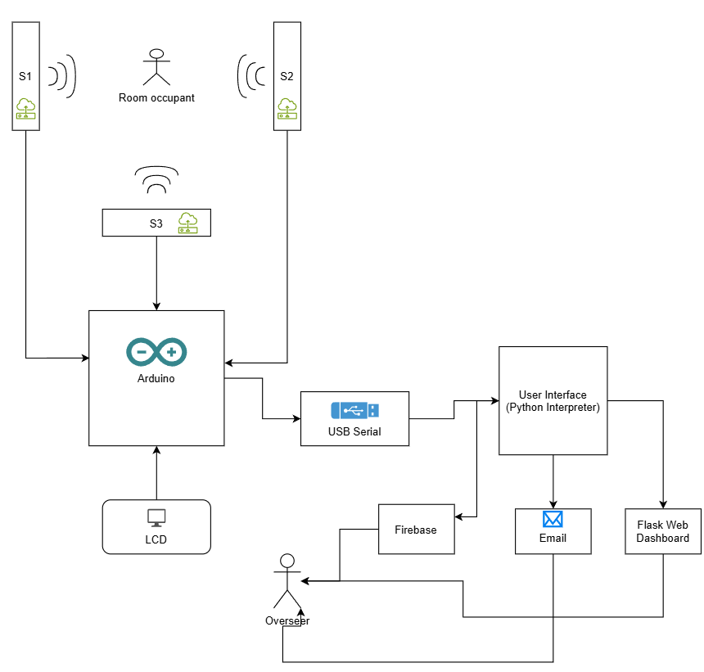
System Architecture

Slide 5
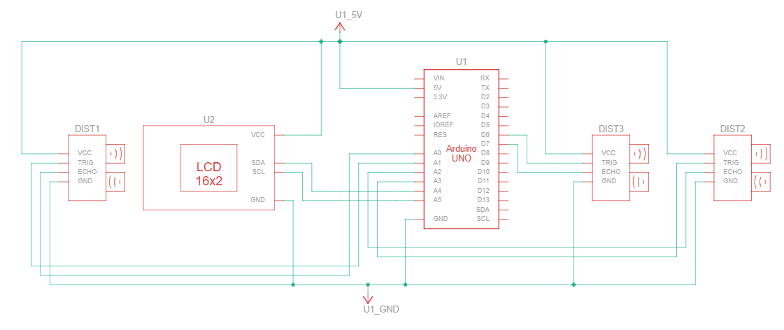
Hardware Components
Arduino Uno
3 × Ultrasonic Sensors (HC-SR04)
I2C LCD Display
Breadboard, jumper wires

Slide 6
Software & Tools
Arduino IDE (Sensor reading + LCD + Serial JSON)
Python (Serial, Flask, Firebase, SMTP email)
Firebase Realtime Database (Cloud storage)
Chart.js + HTML Dashboard for real-time visualization

Slide 7
Key Features
Location Estimation:“Front Left”, “Back Center” on LCD
Alerts:Stillness > 1 min → EmailObject very close (<10 cm) → Email
Data Visualization:Live dashboard with charts

Slide 8
Arduino Implementation
Reads 3 ultrasonic sensors
Displays location on LCD
Sends JSON data over Serial
Example JSON:
{"S1": 123, "S2": 145, "S3": 134}

Slide 9
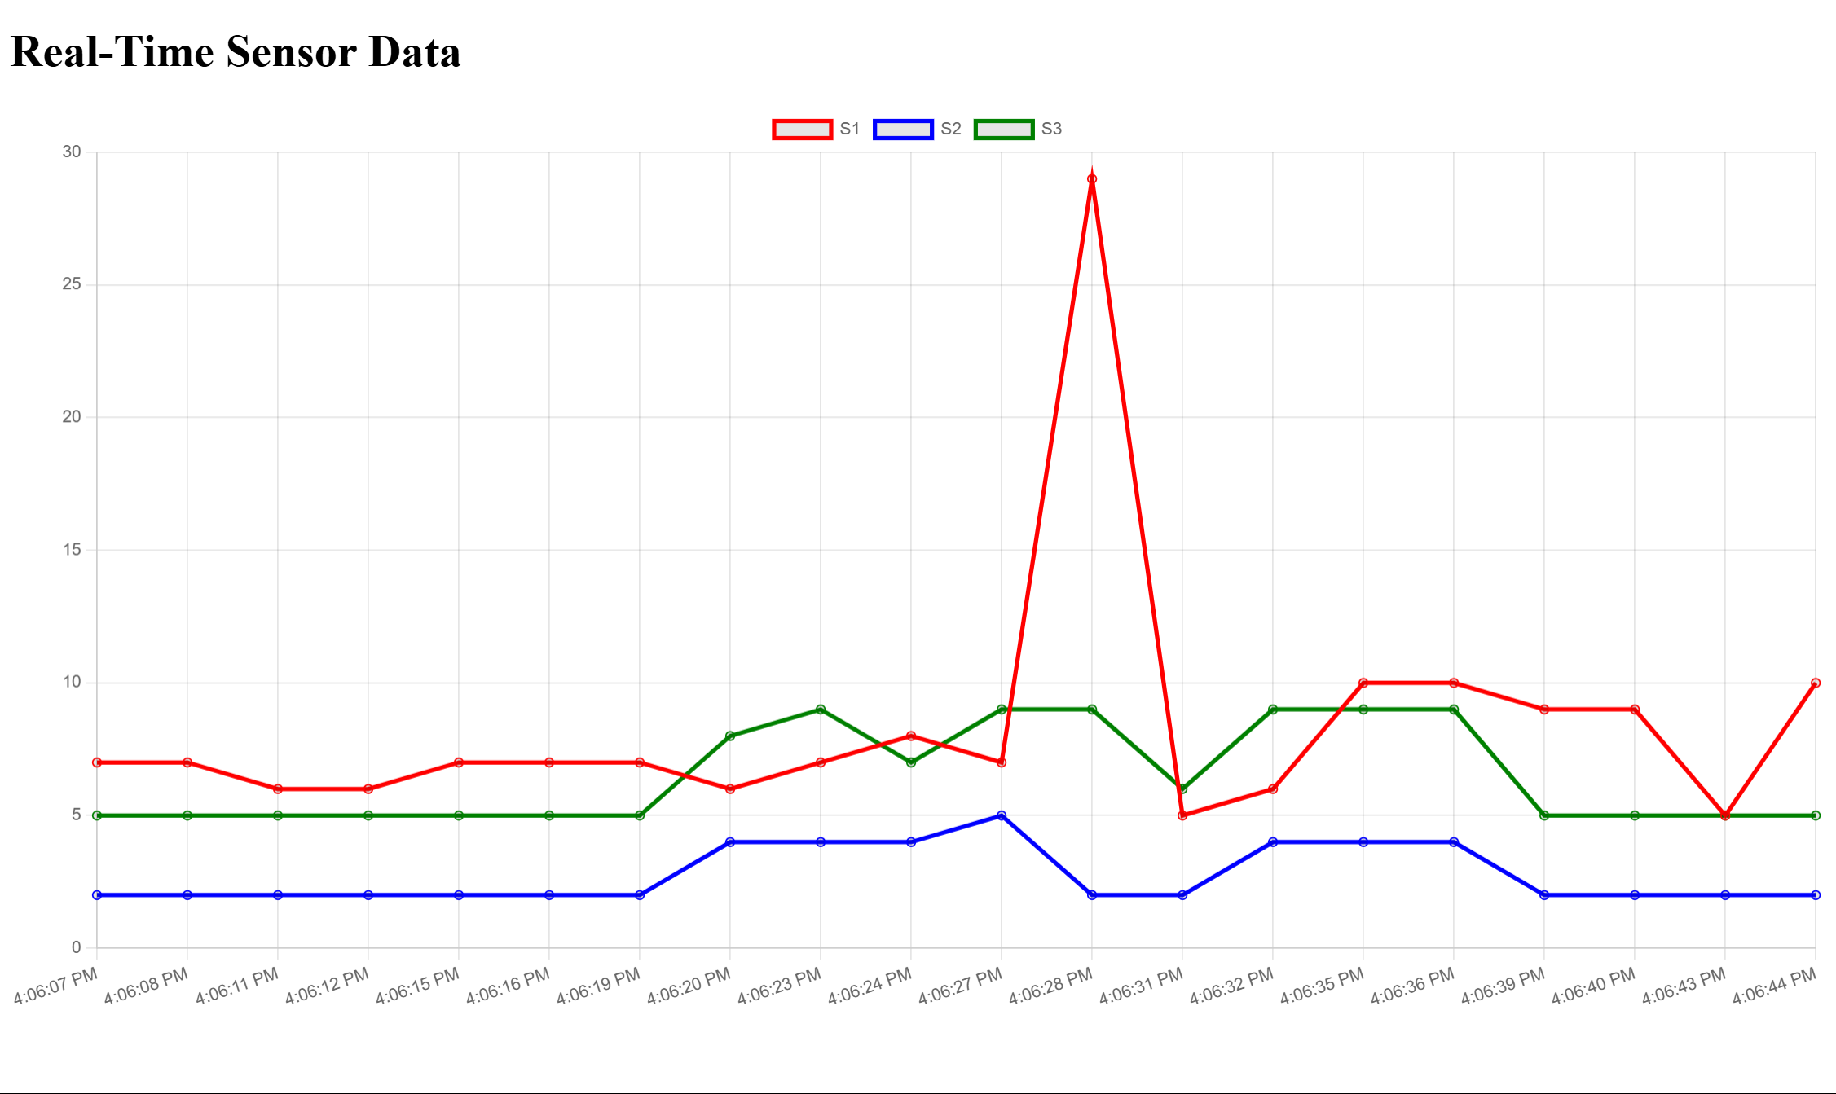
Python Integration
Serial → Firebase → Dashboard
Email alerts using Mailtrap SMTP
Flask for real-time chart:

Slide 10
Results
System tested for movement detection
Stillness detection accuracy: ±1 cm tolerance
Firebase logs verified
Dashboard updated every 2 seconds

Slide 11
Future Improvements
Add ESP32 wireless nodes
Implement MQTT for scalability
Historical trend analysis on dashboard
Mobile app integration

Slide 12
Conclusion
IoT + Embedded systems can enable smart monitoring
Affordable, privacy-preserving, real-time solution
Supports energy savings and automation

